Slide 1

CSE- 207
Algorithms
Lecture: 15
Graph: BFS-DFS
Fahad Ahmed
Lecturer, Dept. of CSE
E-mail: fahadahmed@uap-bd.edu

Slide 2
Graph

Slide 3
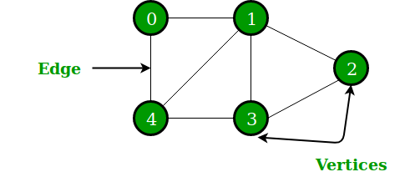
What is Graph?
A Graph is a non-linear data structure consisting of nodes and edges. The nodes are sometimes also referred to as vertices and the edges are lines or arcs that connect any two nodes in the graph.
More formally a Graph can be defined as:
A Graph consists of a finite set of vertices(or nodes) and set of Edges which connect a pair of nodes.

Slide 4
What is Graph?
A graph G = (V, E) consists of a set of objects V = {v₁, v₂, …} called vertices, and another set E = {e₁, e₂, …}, whose elements are called edges, such that each edge e_{k} is identified with an unordered pair (v₁, v₂) of vertices.
Suppose G = (V, E) is a graph where
V = {v₁, v₂, v₃, v₄}
E = {(v₁, v₂), (v₂, v₃), (v₃, v₁), (v₃, v₄)}
V₁
V₄
V₂
V₃

Slide 5


What is Graph?
7
8
7
8
8
8
7
7
2
9
2
1
6
9
1
6
9
1
3
1
3
5
2
3
6
5
2
3
9
6
9
2
5
4
5
4
4
4

Slide 6
Applications of Graph
Job assignments
People
Jobs

Slide 7
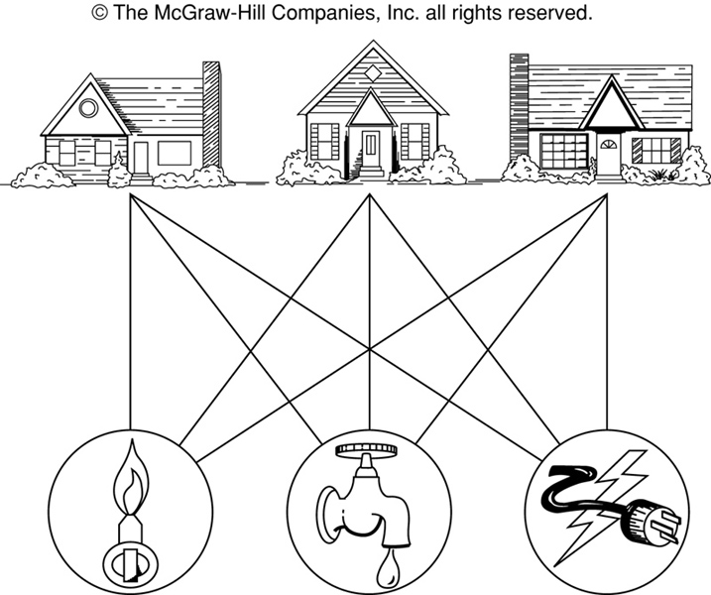
The House-and-Utilities Problem

Slide 8
Applications of Graph
Utilities Problem
H₁
H₂
H₃
W
G
E

Slide 9
Applications of Graph
Graphs are used to define the flow of computation.
Graphs are used to represent networks of communication.
Graphs are used to represent data organization.
Graph transformation systems work on rule-based in-memory manipulation of graphs. Graph databases ensure transaction-safe, persistent storing and querying of graph structured data.
Graph is used to find shortest path in road or a network.

Slide 10
Applications of Graph
Google maps uses graphs for building transportation systems, where intersection of two(or more) roads are considered to be a vertex and the road connecting two vertices is considered to be an edge, thus their navigation system is based on the algorithm to calculate the shortest path between two vertices.
In Facebook, users are considered to be the vertices and if they are friends then there is an edge running between them. Facebook’s Friend suggestion algorithm uses graph theory. Facebook is an example of undirected graph.
In World Wide Web, web pages are considered to be the vertices. There is an edge from a page u to other page v if there is a link of page v on page u. This is an example of Directed graph. It was the basic idea behind Google Page Ranking Algorithm.

Slide 11
Applications of Graph
In Operating System, we come across the Resource Allocation Graph where each process and resources are considered to be vertices. Edges are drawn from resources to the allocated process, or from requesting process to the requested resource. If this leads to any formation of a cycle then a deadlock will occur.
Blockchains also use graphs. The nodes are blocks that store many transactions while the edges connect subsequent blocks.

Slide 12
Applications of Graph :
In Electrical Engineering, graph theory is used in designing of circuit connections. These circuit connections are named as topologies. Some topologies are series, bridge, star and parallel topologies.
In linguistics, graphs are mostly used for parsing of a language tree and grammar of a language tree.
Physics and Chemistry
The 3D structure of complicated simulated atomic structures can be studied quantitatively by gathering statistics on graph-theoretic properties related to the topology of the atoms.
Graphs are also used to express the micro-scale channels of porous media, in which the vertices represent the pores and the edges represent the smaller channels connecting the pores.

Slide 13
Applications of Graph in Biology
Nodes in biological networks represent bimolecular such as genes, proteins or metabolites, and edges connecting these nodes indicate functional, physical or chemical interactions between the corresponding bimolecular.
Graph theory is used in transcriptional regulation networks.
It is also used in Metabolic networks.
In PPI (Protein - Protein interaction) networks graph theory is also useful.
Characterizing drug - drug target relationships.

Slide 14
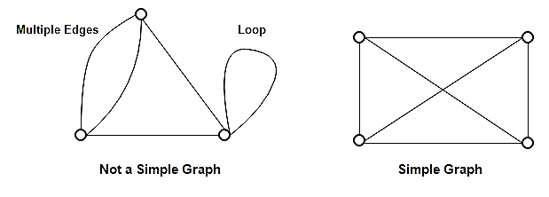
Graph Terminology
Simple Graph
A simple graph is the undirected graph with no parallel edges and no loops.
A simple graph which has n vertices, the degree of every vertex is at most n -1.
Example
In the above example, First graph is not a simple graph because it has two edges between the vertices A and B and it also has a loop.
Second graph is a simple graph because it does not contain any loop and parallel edges.

Slide 15
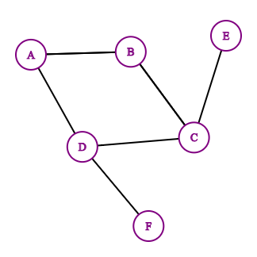
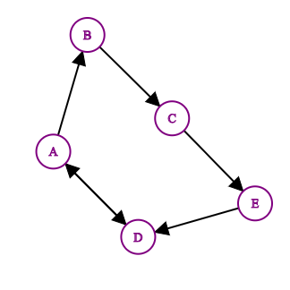
Graph Terminology
An undirected graph is when edges have no direction.
A directed graph is when edges have a direction.

Slide 16
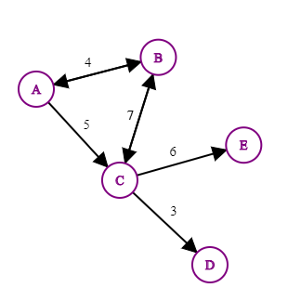
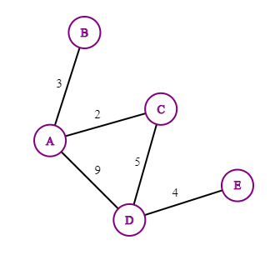
Graph Terminology
A weighted and directed graph is where edges have a direction and a numerical value!
A weighted graph is when edges have a numerical value.

Slide 17
Graph Terminology
Path: sequence of vertices in which each pair of successive vertices is connected by an edge
Cycle: a path that starts and ends on the same vertex
Simple path: a path that does not cross itself
That is, no vertex is repeated (except first and last)
Simple paths cannot contain cycles
Closed Path: A path will be called as closed path if the initial node is same as terminal node.
Length of a path: Number of edges in the path
Sometimes the sum of the weights of the edges
Sub-graph is a subset of vertices and edges.

Slide 18
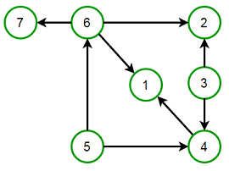
Graph Terminology
A Cyclic graph contains cycles
An acyclic graph contains no cycles
Directed Acyclic Graph (DAG)
A Directed Acyclic Graph (DAG) is a directed graph that contains no cycles.

Slide 19
Representation of Graphs
Two standard ways.
Adjacency Lists.
Adjacency Matrix.
a
b
a
b
d
c
b
a
c
c
d
c
d
a
b
d
a
c
1
2
1 2 3 4
1 0 1 1 1
2 1 0 1 0
3 1 1 0 1
4 1 0 1 0
a
b
c
d
3
4

Slide 20
Adjacency Lists
Consists of an array Adj of |V| lists.
One list per vertex.
For u ∈ V, Adj[u] consists of all vertices adjacent to u.
a
b
a
b
d
c
b
c
If weighted, store weights also in adjacency lists.
c
d
c
d
d
a
b
a
b
d
c
b
a
c
c
d
c
d
a
b
d
a
c

Slide 21
Storage Requirement
For directed graphs:
Sum of lengths of all adj. lists is
∑out-degree(v) = |E|
^{v∈V}
Total storage: Θ(V+E)
For undirected graphs:
Sum of lengths of all adj. lists is
∑degree(v) = 2|E|
^{v∈V}
Total storage: Θ(V+E)
No. of edges leaving v
No. of edges incident on v. Edge (u,v) is incident on vertices u and v.

Slide 22
Pros and Cons: adj list
Pros
Space-efficient, when a graph is sparse.
Can be modified to support many graph variants.
Cons
Determining if an edge (u,v) ∈G is not efficient.
Have to search in u’s adjacency list. Θ(degree(u)) time.
Θ(V) in the worst case.

Slide 23
Adjacency Matrix
|V| × |V| matrix A.
Number vertices from 1 to |V| in some arbitrary manner.
A is then given by:
1
2
1 2 3 4
1 0 1 1 1
2 0 0 1 0
3 0 0 0 1
4 0 0 0 0
1
2
1 2 3 4
1 0 1 1 1
2 1 0 1 0
3 1 1 0 1
4 1 0 1 0
a
b
a
b
c
d
4
3
c
d
4
3
A = A^{T} for undirected graphs.

Slide 24
Space and Time
Space: Θ(V²).
Not memory efficient for large graphs.
Time: to list all vertices adjacent to u: Θ(V).
Time: to determine if (u, v) ∈ E: Θ(1).
Can store weights instead of bits for weighted graph.

Slide 25
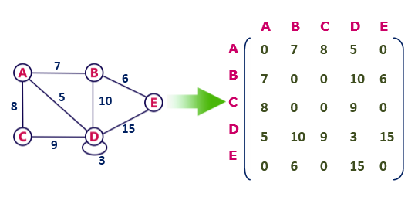
Adjacency Matrix
Undirected weighted graph representation

Slide 26
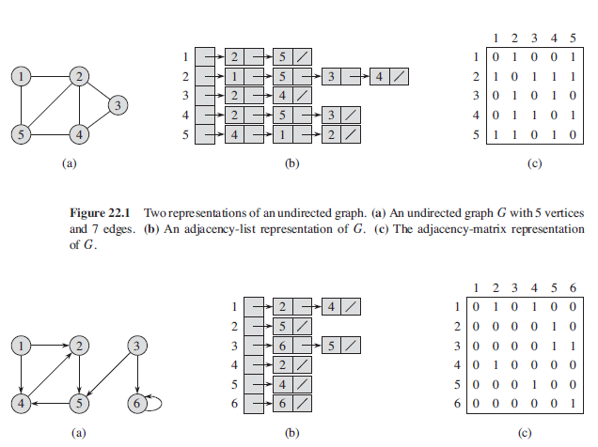
Graph Representation – List vs. Matrix

Slide 27
Graph Representation –
c
To
a b c d e f
From
b
d
f
a
b
c
d
e
f
0 1 0 0 1 1
1 0 1 0 0 1
0 1 0 1 0 1
0 0 1 0 1 1
1 0 0 1 0 1
1 1 1 1 1 0
a
e
W₅
{v₁,v₂}
row column

Slide 28
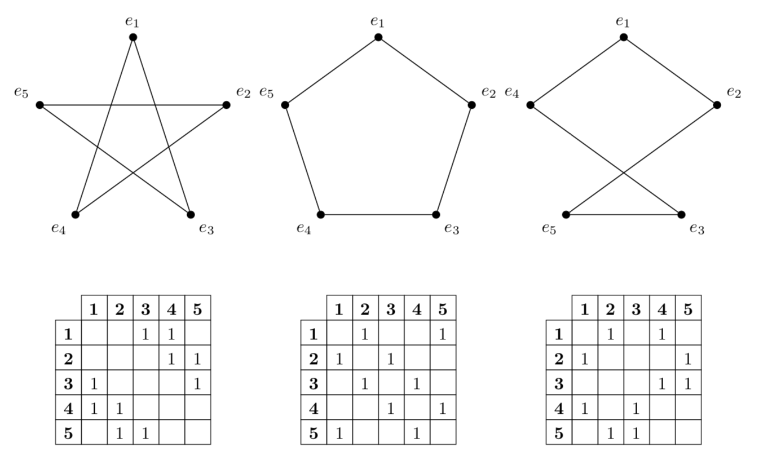
Graph Representation –

Slide 29
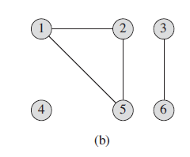
Connected Component
An undirected graph is connected if there is a path between every pair of vertices.
A connected component of an undirected graph is a maximal set of nodes such that each pair of nodes is connected by a path.

Slide 30
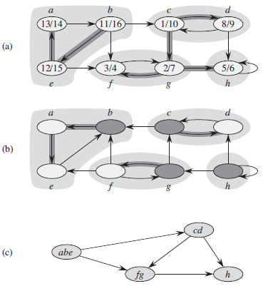
Strongly Connected Components
A graph is strongly connected if every vertex is reachable from every other vertex.
The strongly connected components of a directed graph is the subgraph where every vertex is reachable from every other vertices.

Slide 31
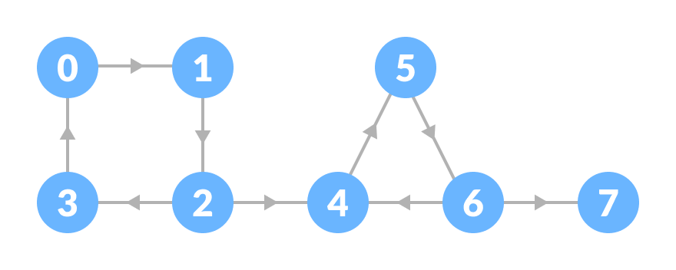
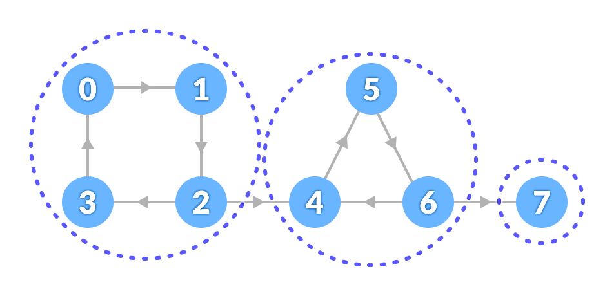
Strongly Connected Components

Slide 32
Connected Components
Connected (Strongly or not) components form a partition of the set of graph vertices, meaning
connected components are non-empty,
they are pair-wise disjoints, and
the union of connected components forms the set of all vertices.
Algorithm to find the strong connectivity of a graph takes linear time ( Θ(V+E)).
Kosaraju's Algorithm is based on the depth-first search algorithm used to find Connected Components

Slide 33
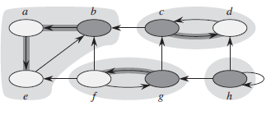
Connected Components
Connected components count
Count of disjoint connected components
Size of connected component
number of vertices in a component
Figure
Fig 1: has 3 connected components with 3 different sizes
Fig 2: has 4 connected components with 3 different sizes
Fig 1
Fig 2

Slide 34
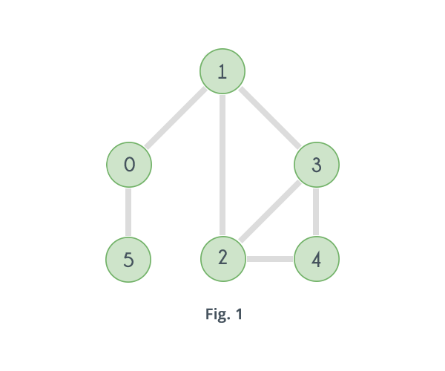
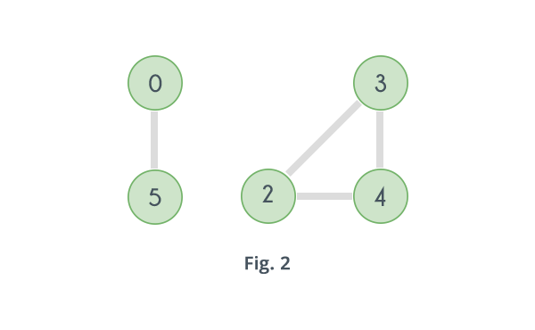
articulation point
A vertex is said to be an articulation point in a graph if removal of the vertex and associated edges disconnects the graph.
Articulation points represent vulnerabilities in a connected network – single points whose failure would split the network into 2 or more components. They are useful for designing reliable networks.
Articulation points and bridges (Tarjan's Algorithm)

Slide 35
Reference
Chapter 22 (22.1, 22.2, 22.3, 22.4) (Cormen)
https://www.geeksforgeeks.org/graph-data-structure-and-algorithms/#connectivity

Slide 36

Thanks to All

